Slide 1
Loops
Python: Next steps

Slide 2
Learning Objectives
Use a while loop to repeat a section of code
Use a for loop to repeat a section of code
Make a choice about which loop to use, and why

Slide 3
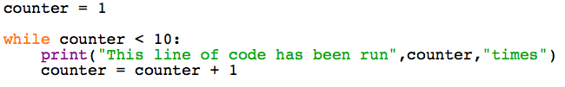
Starter
Reading Code
What will print the first time this loop runs?
How many times will this loop run?

Slide 4
while() Loops
The pseudocode might be:
while theGuess is not equal to theAnswer:
say That’s wrong, try again
listen for a new guess

Slide 5
while() Loops
Open the file guessGame.py and use this code to finish the program
while guess != answer:
print("That’s wrong, try again")
guess = input("Guess the number")

Slide 6
for() Loops
With the guessing game, did you know how many times you would have to repeat the code until the player got it right?
while() loops are great when you don’t
for() loops are perfect when you DO know how many times you want something to repeat

Slide 7
for() Loops
Suppose you want to print out all the numbers up to 10:
Try this code:
for counter in range(10):
print(counter)

Slide 8
for() Loops
Did it work?
Remember that computers count from 0
Try changing the program so that it prints out all the numbers from 0 to 10
How about from 0 to 25?
0,1,2,3,4,5…

Slide 9
for() Loops
If you run a for() loop using 2 numbers you can change the way it works.
Try this code:
for counter in range(5,10):
print(counter)

Slide 10
for() Loops
What happened?
Try changing the program so that it prints:
all the numbers from 10 to 20
all the numbers from 17 to 31

Slide 11
Worksheet 3
Complete the worksheet to check your knowledge of while() loops and for() loops

Slide 12
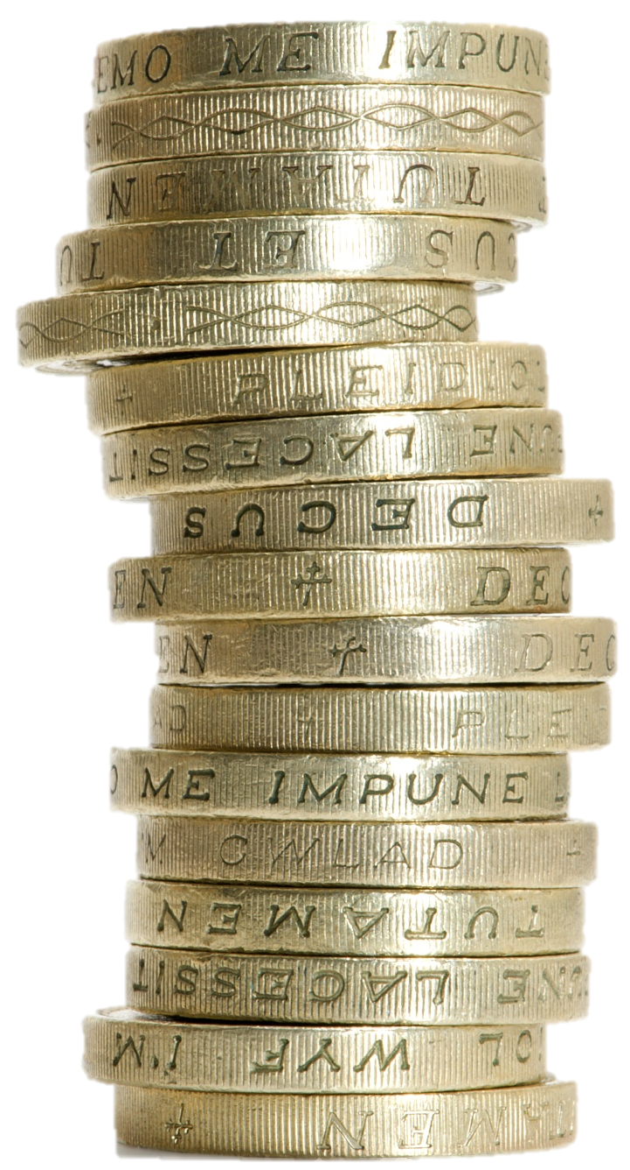
Worksheet 4
Imagine asking for 1p per week pocket money
Next week it will go up to 2p and then to 4p
This might sound like a bad deal, but complete the tasks on the worksheet and you might find out it will work out better than you think

